Slide 1
Paraphrasing Tool

Slide 2
What is paraphrase ?

Slide 3
Definition
Paraphrase refers to the restatement of a text, passage, or idea in different words, while retaining its original meaning.
In linguistics, paraphrase is often described in terms of a semantic relationship between two or more expressions that have the same meaning or convey similar information.

Slide 4
Topology
In terms of topology, paraphrase can be classified into several categories, including:
Lexical Paraphrase
Syntactic Paraphrase
Semantic Paraphrase
Pragmatic Paraphrase

Slide 5
Ambiguity of Language
Ambiguity of language refers to the phenomenon where the meaning of a word or phrase is not clear or can be interpreted in multiple ways.

Slide 6
Some Examples of Sentences Ambiguity are:
I saw the man with telescope.
The chicken is ready to eat.
I have a new friend who is an English teacher.
I saw the bat fly over the tree with the binoculars.
Time flies like an arrow; fruit flies like a banana.

Slide 7
Challenges associated with paraphrasing tool
Maintaining meaning
Avoiding plagiarism
Capturing language variability
Evaluating effectiveness
Data availability

Slide 8
Model Selection

Slide 9
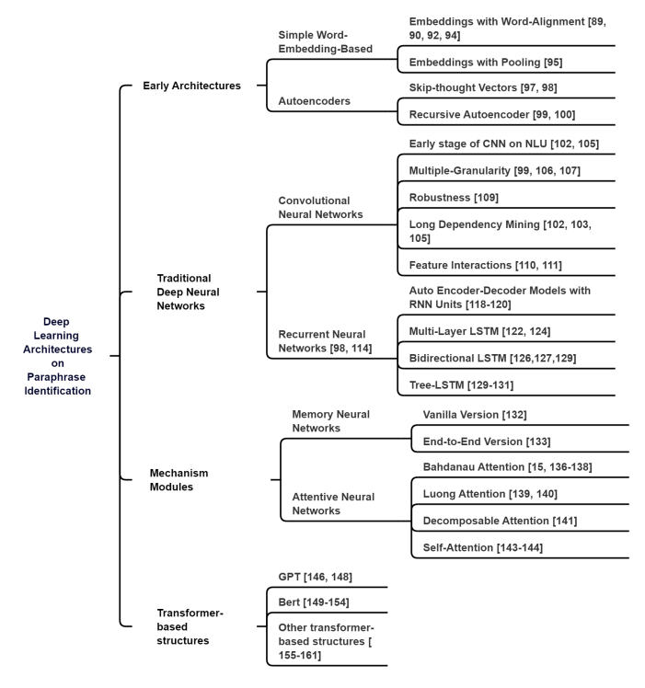
Paraphrase Identification with Deep Learning:A Review of Datasets and Methods
Chao Zhou (Department of Computer Science, Syracuse University), Cheng Qiu (School of Arts and Science, Vanderbilt University), Daniel E. Acuna (Department of Computer Science, University of Colorado at Boulder)
[2212.06933] Paraphrase Identification with Deep Learning: A Review of Datasets and Methods (arxiv.org)

Slide 10
Using the Transformer architecture for paraphrasing in Python
Introduction
Paraphrasing is the task of restating a sentence or phrase in a different way while preserving its meaning.
The Transformer architecture is a powerful deep learning model that has been shown to be effective for a wide range of natural language processing tasks, including paraphrasing.
The Hugging Face Transformers library
The Hugging Face Transformers library is a popular open-source library for working with pre-trained Transformer-based models in Python.
The library provides a simple and intuitive interface for loading pre-trained models and generating paraphrases using these models.
We have used the Hugging Face Transformers library to load a pre-trained paraphrasing model, such as the Pegasus model.

Slide 11
The Transformer architecture is generally a better choice than CNNs or RNNs for a paraphrasing tool project, for several reasons:
Ability to handle long-term dependencies:
In a paraphrasing task, it's important to be able to recognize and maintain coherence between words and phrases that may be far apart in the input sentence.
Lower computational complexity:
The Transformer model is designed to be parallelizable, which means that it can be more efficient to train than other models like RNNs that have sequential dependencies between time steps.
Ability to generate more diverse output:
In a paraphrasing task, it's desirable to generate output that is not only accurate, but also diverse and creative.
A. Vaswani, N. Shazeer, N. Parmar, J. Uszkoreit, L. Jones, A. N. Gomez, L. Kaiser, and I. Polosukhin, “Attention is all you need,”
CoRR, vol. abs/1706.03762, 2017. [Online]. Available: http://arxiv.org/abs/1706.03762
Transformers, explained: Understand the model behind GPT, BERT, and T5 - YouTube
Notes:
Transformer-based Structure: The Transformer was proposed by [145] as an alternative to recurrent neural networks. It is based solely on the self-attention mechanism, and uses an encoder-decoder architecture. The selfattention mechanism is used in the Transformer’s first sub-layer of the encoder to process all words in a sentence simultaneously and build dependencies between them. Compared to RNNs and CNNs, this modified structure allows for faster learning of long-term dependencies. The self-attention mechanism in the Transformer also allows for significantly more parallelism, which breaks the limitation of RNNs on sequential computations. Additionally, the Transformer provides a more structured memory, similar to memory networks, for better handling of long-term dependencies in text. The Transformer has led to the development of other models that use only the encoder or decoder, such as GPT, BERT, and XLNet. While the application of these ideas to paraphrase identification is less developed than other approaches discussed above, transformer-based embeddings are commonly used in downstream tasks such as paraphrase identification.

Slide 12
Benefits and limitations of using the Transformer architecture for paraphrasing
Benefits
The Transformer architecture is highly effective at capturing complex patterns in language and generating high-quality paraphrases.
Pre-trained models can be easily fine-tuned on specific paraphrasing tasks, allowing for fast and efficient development of custom models.
Limitations
Pre-trained models may not capture all of the nuances of the specific domain or language being used, leading to errors or inaccuracies in generated paraphrases.
Fine-tuning models on specific tasks can be time-consuming and require large amounts of data.
The high computational requirements of the Transformer architecture may make it difficult to deploy models on resource-constrained devices or systems.

Slide 13
THANK YOU

